Slide 1
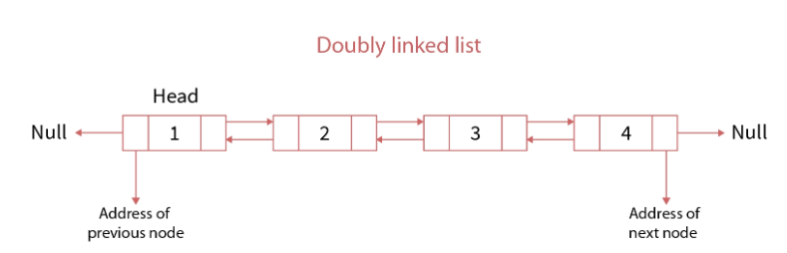
Linked List Structure

Slide 2
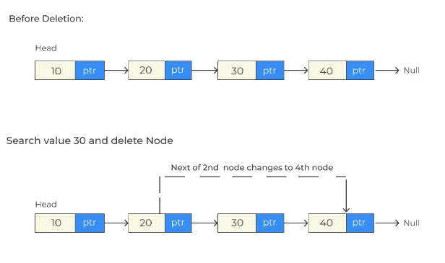
Deletion in Linked List for a value in Java

Slide 3
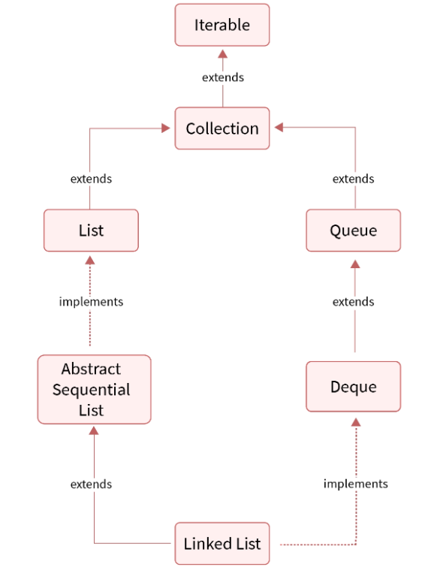
Hierarchy of LinkedList class in Java

Slide 4
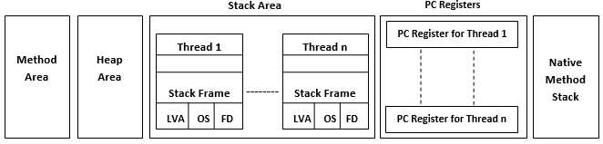
Java Memory Model

Slide 5
1. Method Area: Method Area is a part of the heap memory which is shared among all the threads. It is used to store a below items:
- class structure
- superclass name
- interface name
- constructors
2. Heap Area: Heap stores the actual objects
e.g., StringBuilder sb= new StringBuilder();
3. Stack Area: Stack Area generates when a thread creates. It is one of the Data Structure.
e.g., StringBuilder sb= new StringBuilder(); -------------------- Here, “sb” takes the stack memory
4. PC Registers: Each thread has a Program Counter (PC) register associated with it. PC register stores the return address or a native pointer. It also contains the address of the JVM instructions currently being executed
5. Native Method Stack: It is a stack for native code written in a language other than Java. Java Native Interface (JNI) calls the native stack

Slide 6
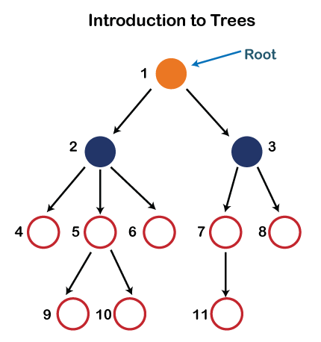
Internal working of the Tree

Slide 7
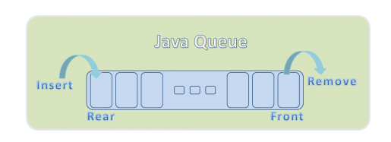
Queue in Java

Slide 8
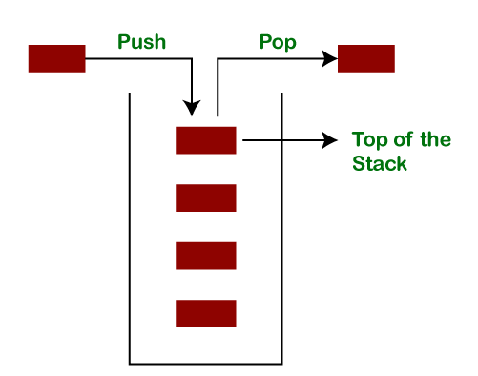
Stack in Java

